Slide 1
UAV Route Planning Strategies for Efficient Coverage Search in Complex Environments
Gabriel Rovesti
Exam of 19th September 2024
Prof. Claudio Enrico Palazzi
Wireless Networks for Mobile Applications
2023-2024

Slide 2
Table of contents
Introduction
Overview of approaches
Classical approaches
Probabilistic methods
Nature-inspired algorithms
Multi-UAV coordination
Environment-specific approaches
Military applications
Military applications
Comparison of approaches
Future challenges and research directions
Conclusions

Slide 3
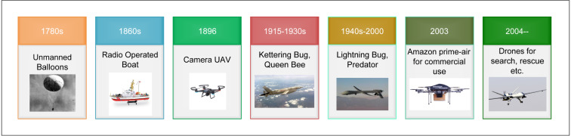
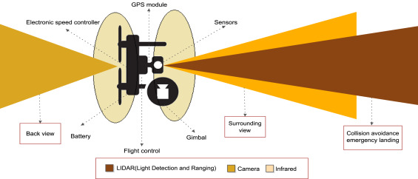
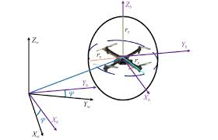
UAV Route Planning
Reference: https://www.sciencedirect.com/science/article/pii/S0140366419308539

Slide 4
Overview of approaches
Classical algorithms
Probabilistic methods
Nature-inspired algorithms
Multi-UAV coordination
Environment-specific approaches
Military applications

Slide 5
Classical approaches
aa

Slide 6
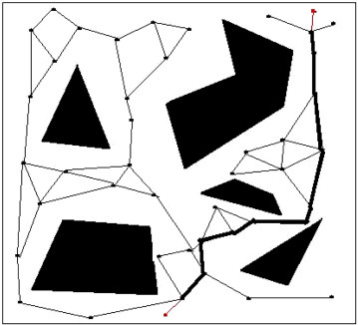
Probabilistic methods
aa
Reference: https://www.sciencedirect.com/science/article/pii/S0140366419308539

Slide 7
Nature-inspired algorithms
aa

Slide 8
Multi-UAV coordination
aa

Slide 9
Environment-specific approaches
aa

Slide 10
Military applications
aa

Slide 11
Comparison of approaches
aa

Slide 12
Future challenges and research directions
aa

Slide 13
Conclusions
aa

